Slide 1
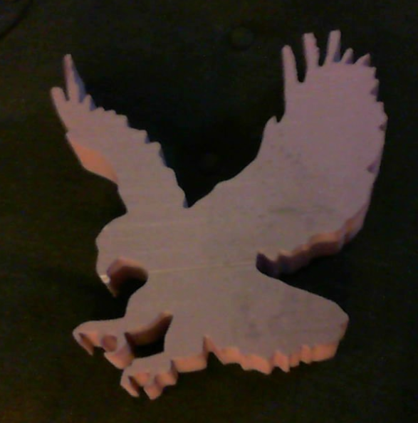
Large Scale Rapid 3D Manufacturing
Adam Blumhagen

Slide 2
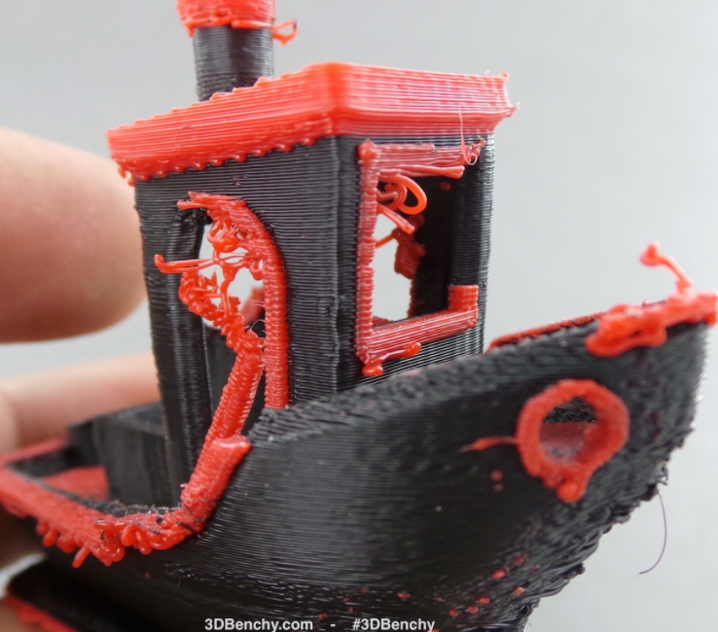
3D print something the size of a boat?
Convential 3D printers are good at printing small things (sometimes), but there are few capable of printing something the size of a car, boat, or house.

Slide 3
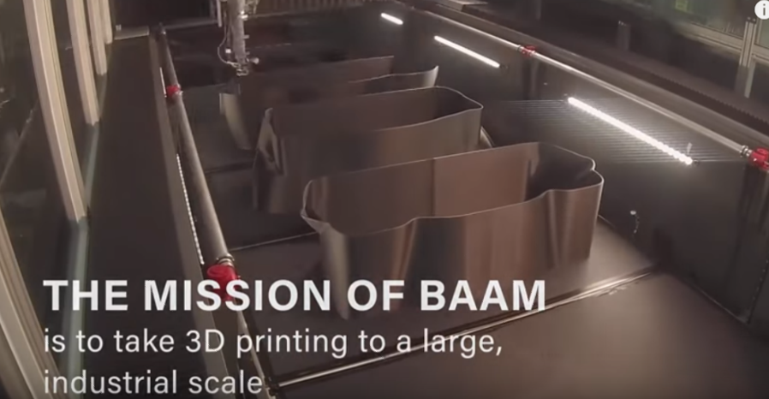
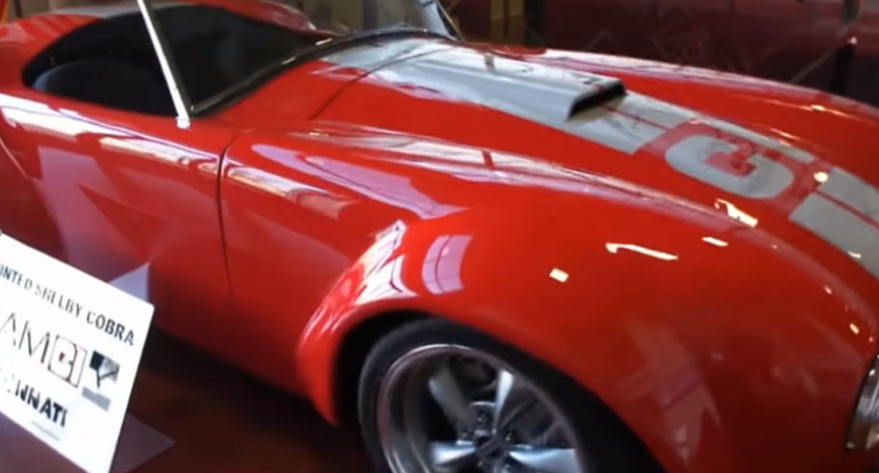
BAAM
https://youtu.be/cyX-v83_5Zg

Slide 4
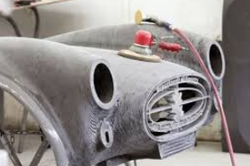
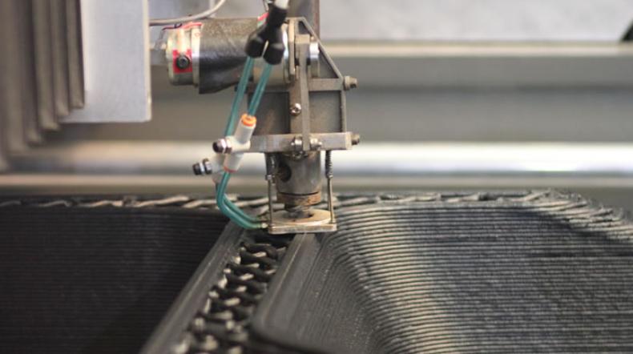

BAAM
BAAM (Big Area Additive Manufacturing) 38lbs of material per hour
Stamps down extruded filament. Poor resolution, still needs filling and sanding.

Slide 5
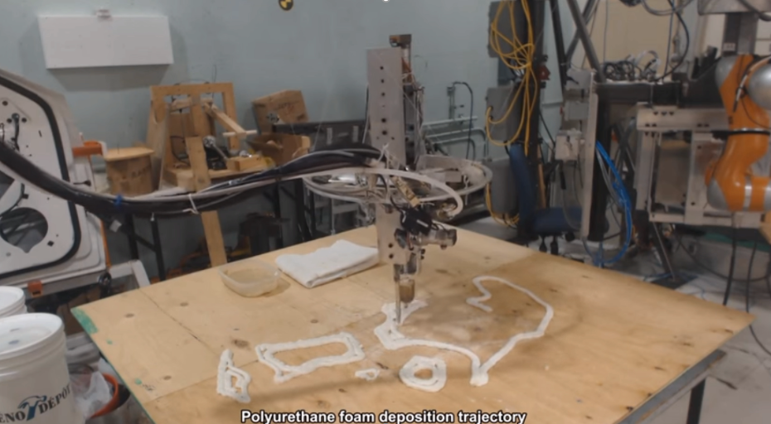
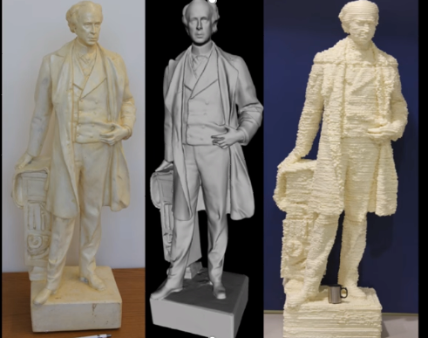
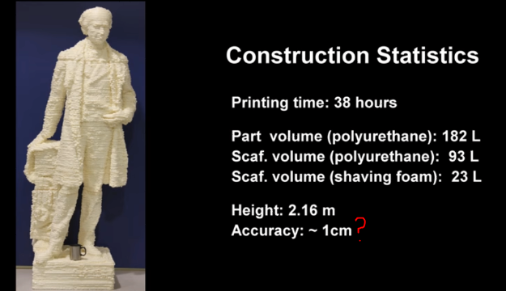
3D Foam Printing
https://www.youtube.com/watch?v=4MNmtJQy_bM

Slide 6
Foam is a great material!
If we could quickly make large parts with foam or bubbles, the parts could be made light yet strong (stronger if coated with a hard polymer or fiberglass), and cheap (less resin is used if the part is mostly hollow).
Large metal parts could also be made by lost foam casting.
Large parts may not need high resolution throughout the entire part. If a method of fast space filling with foam or bubbles could be developed, 3d printing large parts cheaply may be possible. If a section of the part needs high resolution, than use a higher resolution printer for that section.

Slide 7
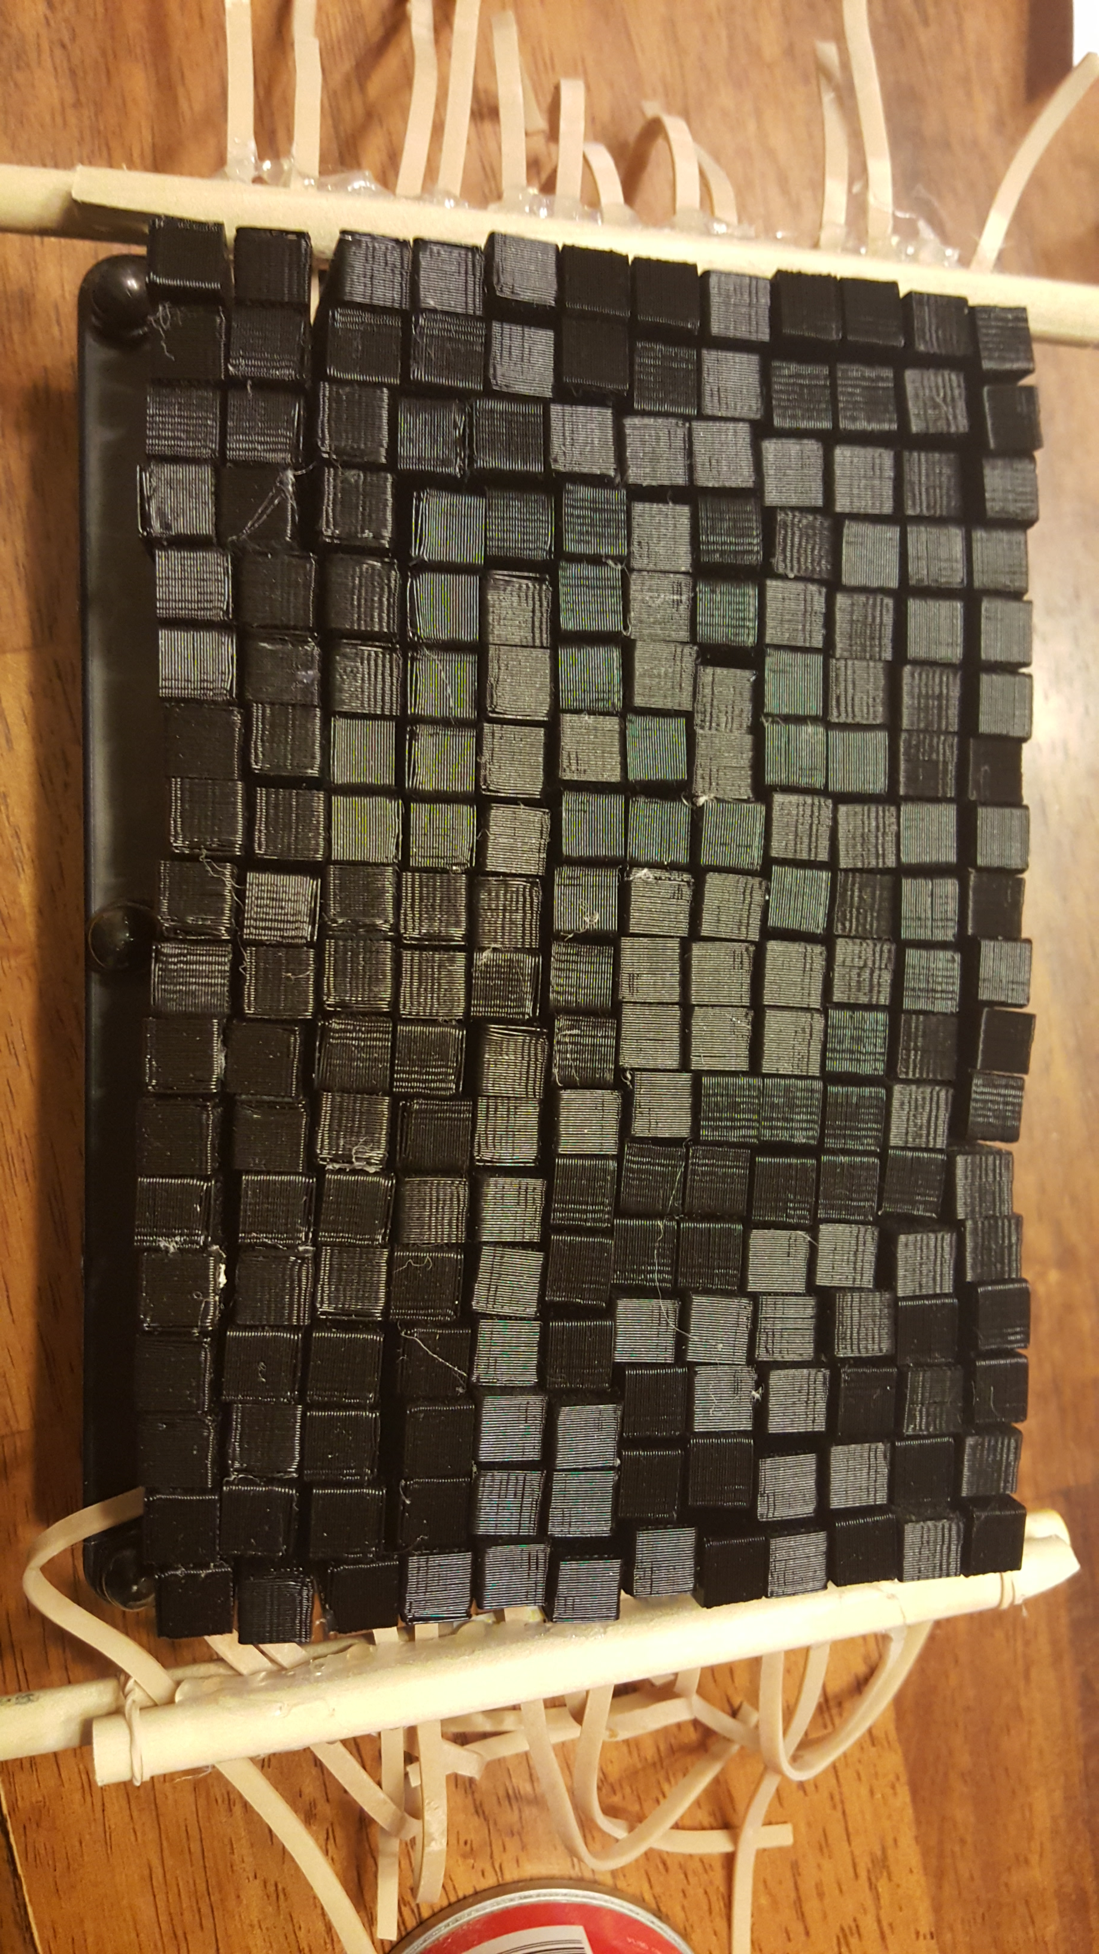
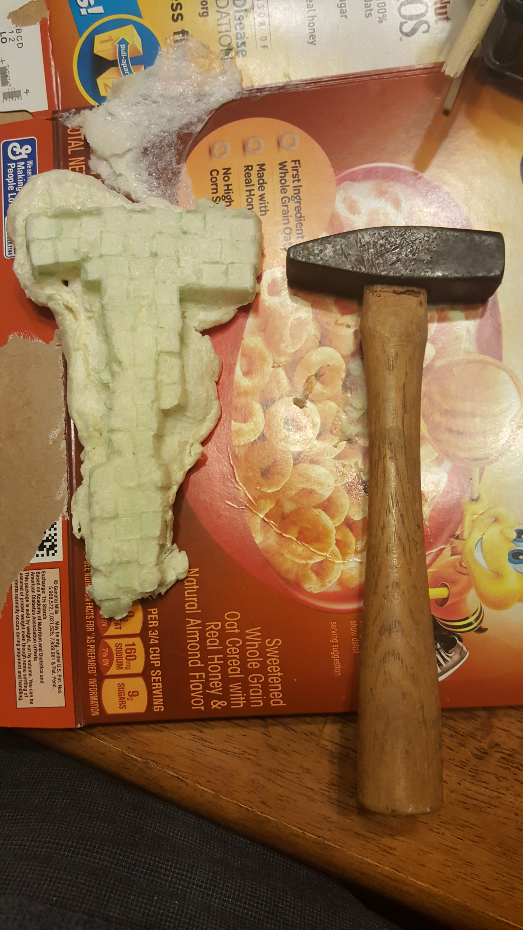
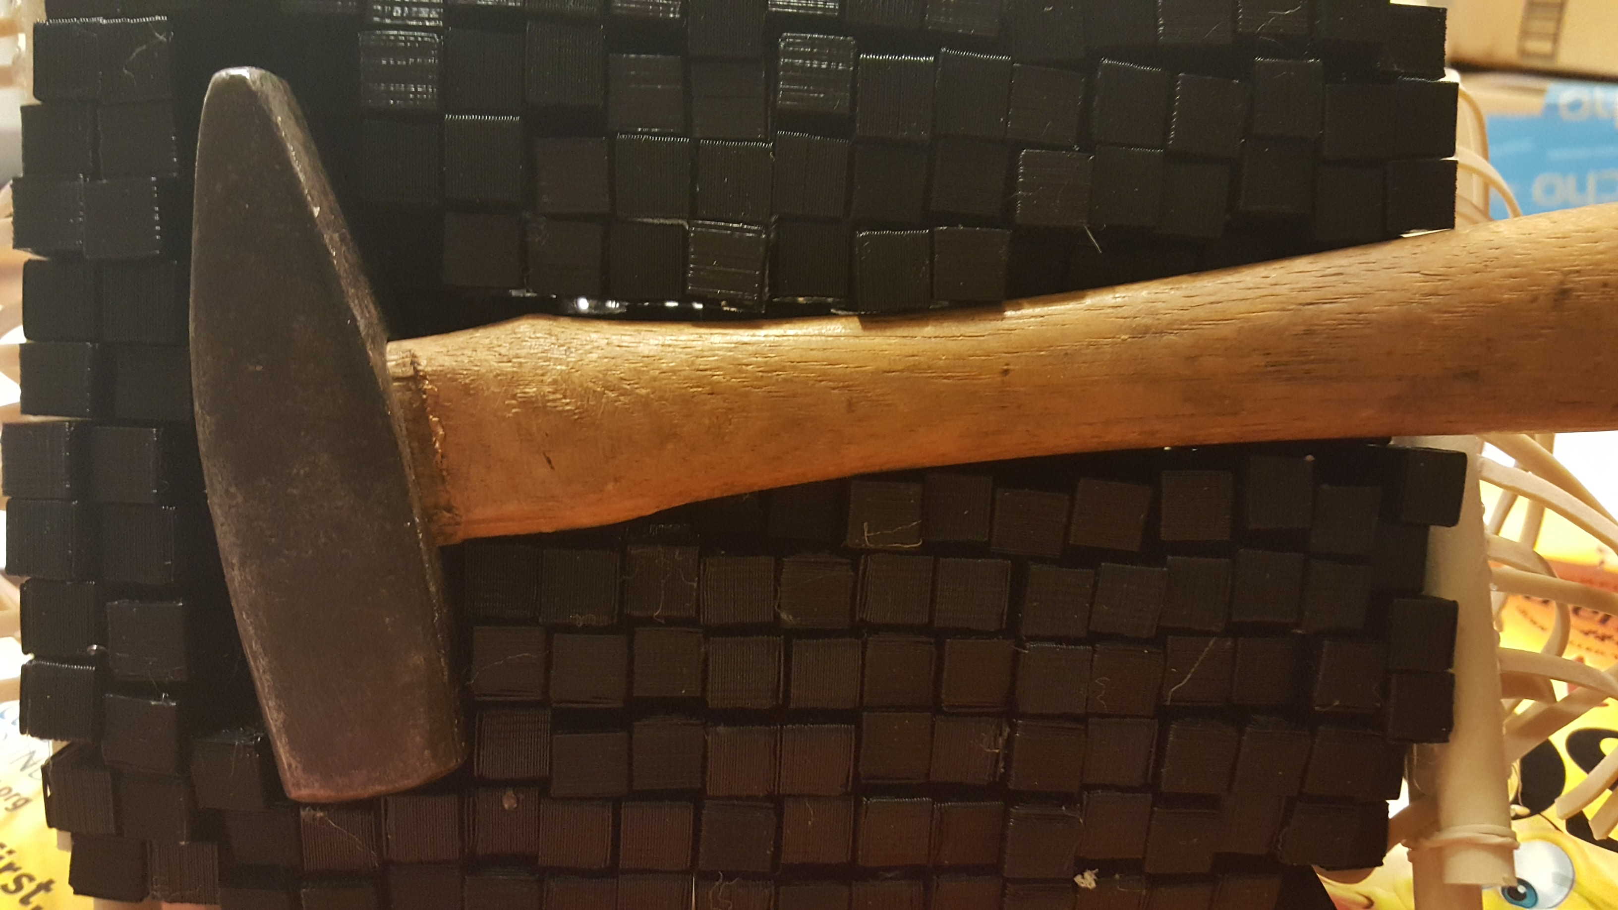
Experiments With Foam-Pin Impression
I was inspired by pin impression toys. (The toy where you put something like your hand on it and the pins make the shape of your hand). If foam could be injected into the shape that the pins make, then parts could be made section-by-section, layer-by-layer. Multiple molds could be suspended from a "skycam" type system of pulleys, allowing for very large parts to be made. I wanted to test theory of injection of foam into the cavity. I 3d printed rectangular shafts and glued them to the ends of pins on a pin impression toy (see the attached picture). The shafts were 1 cm x 1 cm x 25 cm and I took out 4/5 of the pins. Rubber bands were weaved through the pins such that, when pulled tight, the bands kept the pins from moving. You can see in the attached pictures, a small hammer as the cavity for the print and the resulting injected foam shape. It was difficult to get the foam to stay in the cavity (you can see the over fill), the foam stuck to the shafts, and the resolution isn't very good at 1 cm x 1cm.

Slide 8
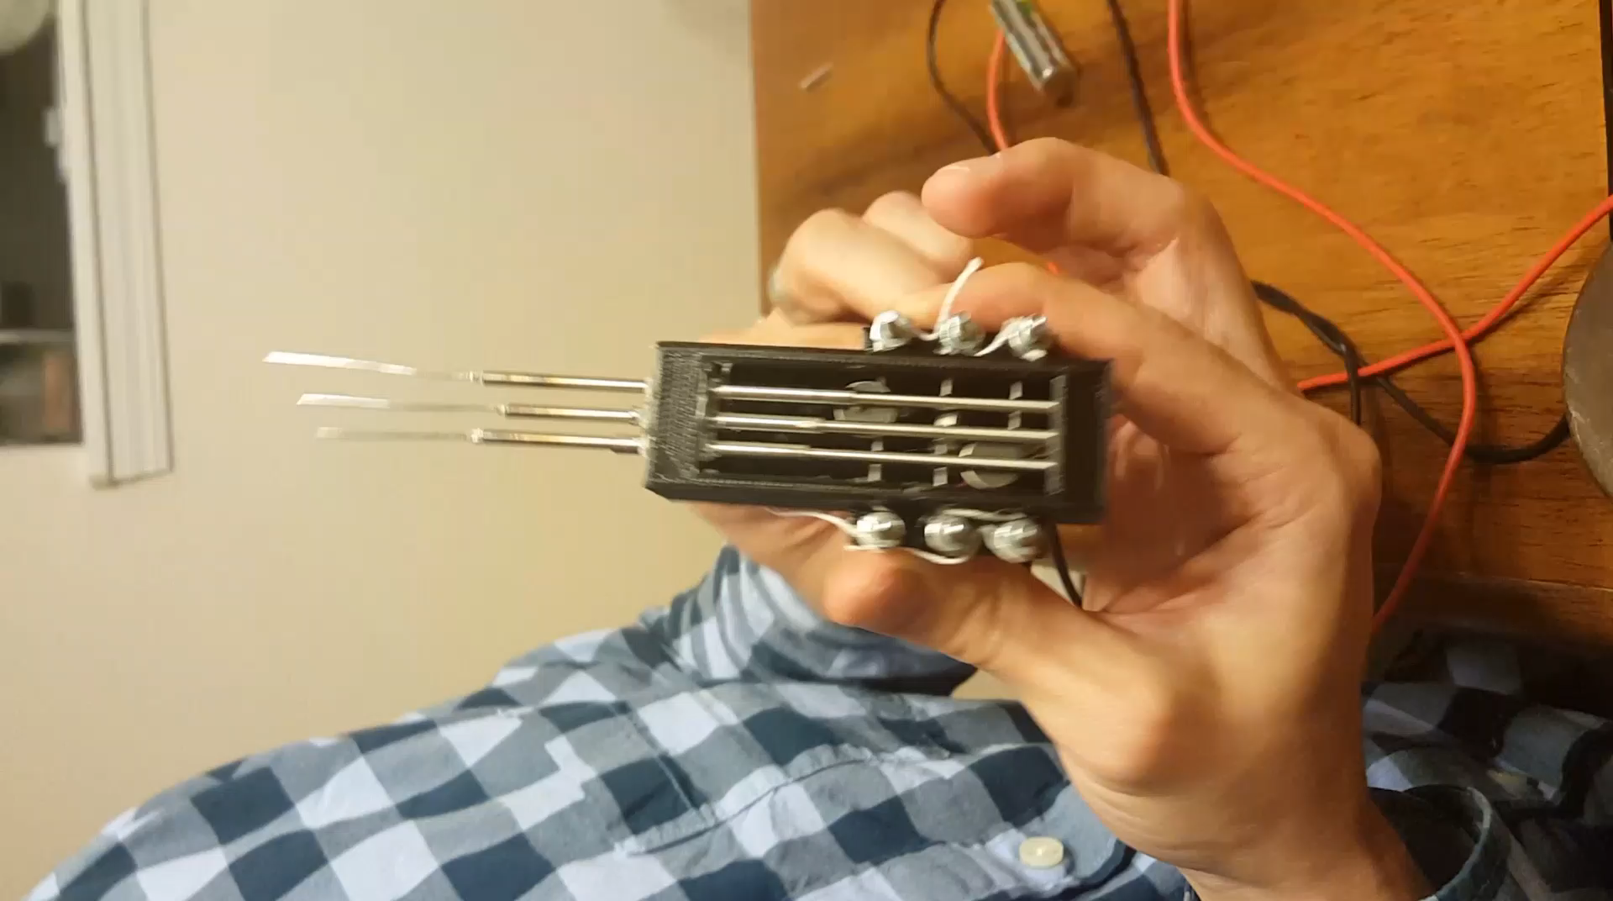
Experiments With Foam-Pin Impression
The distance between the pins sets the resolution of the print, so better resolution requires many pins bunched close together. Conventional stepper motors would be too large and too expensive to actuate so many pins, so I came up with a different method to actuate the pins. I took cellphone vibrating motors (<$1 each and about the size of a dime), they are pressed against the pin and causing friction between the pin and motor. When powered, the vibration of the motor breaks the static friction and the pin moves down by gravity. The pin is coated with a thin polymer, and is in a metal sheath, creating a cylindrical capacitor. As the pin moves into the sheath, the overlapping area between the pin and the sheath changes and therefore the capacitance changes. This allows us to know the location of the pin.
Results: Too complicated (would also require a “skycam” type positioning system), bad resolution.

Slide 9
Experiments With Foam-Polargraph type foam cutter
I was inspired by a video of the creation of the "Bailey Blade" (you can see it in the link: https://www.youtube.com/watch?v=BJFSXIP6Vw8) and Autodesk's 123make app (http://www.123dapp.com/make). Cross sections of the part are cut and stacked together. Instead of wasting time waiting for the foam to expand, use foam that has already been made and cut it to shape and stack the pieces. I was also inspired by the makelangelo drawing robot (http://www.makelangelo.com). The experiment I plan to do: use two makelangelo type drawing robots with a hot wire stretched between them to cut cross sections of foam, then add those pieces to make the shape. One robot does one contour while the other robot does the next contour.

Slide 10
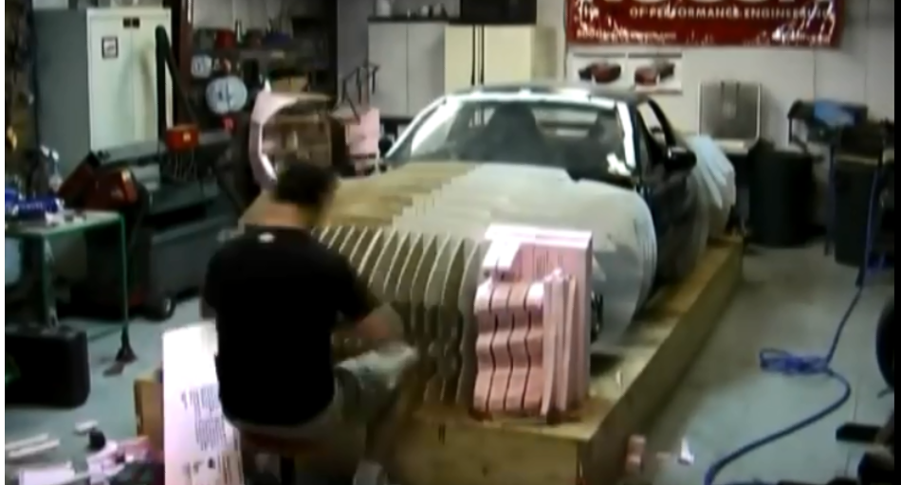
Inspiration-Bailey Blade

Slide 11
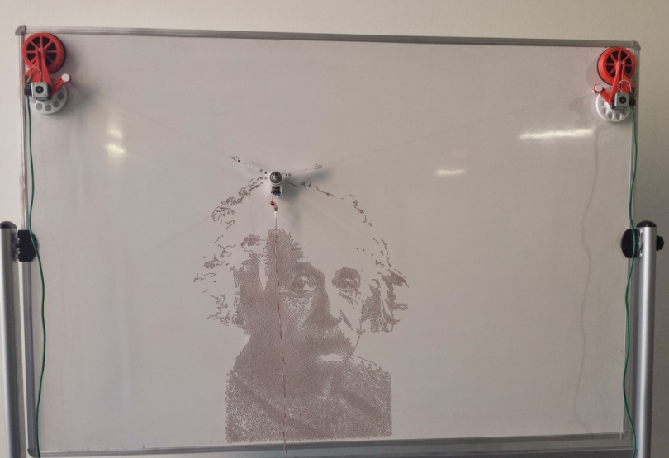
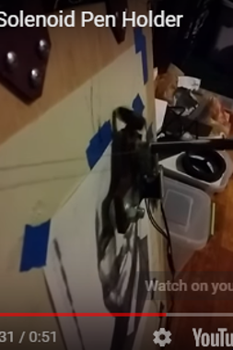
Inspiration-Polargraph Drawing Robots
http://www.quickdrawbot.com/

Slide 12
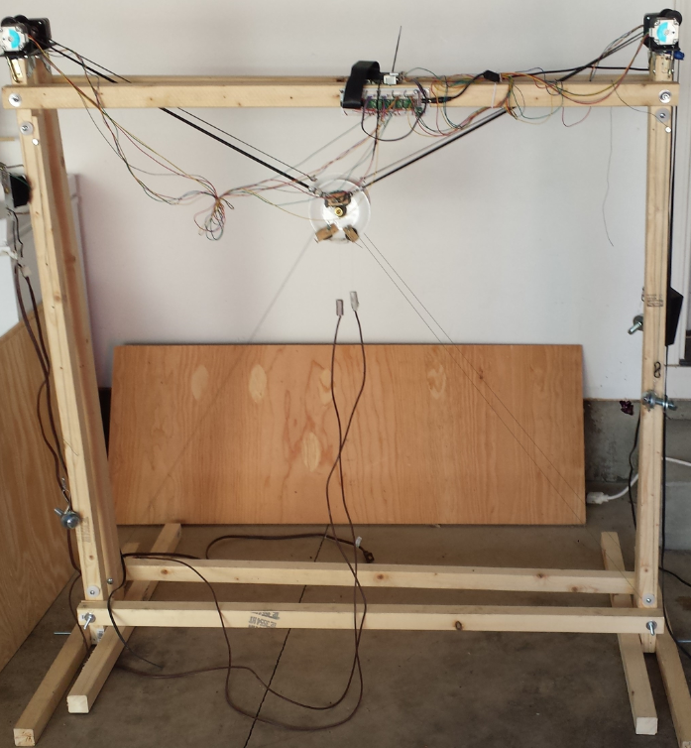
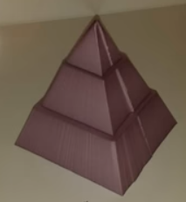
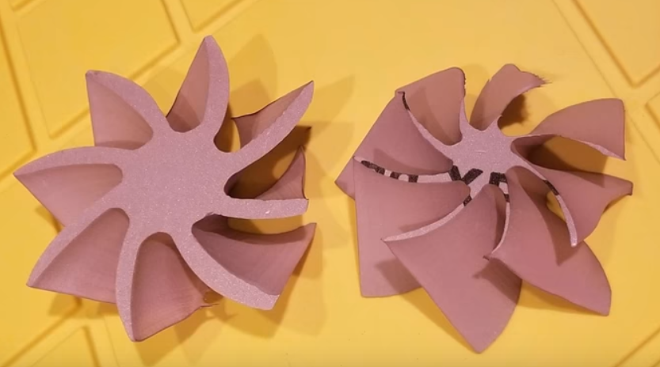
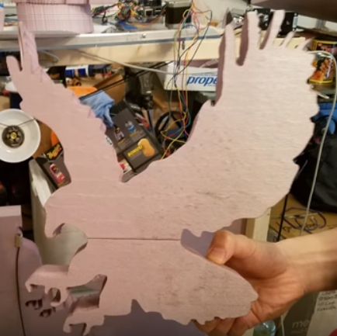
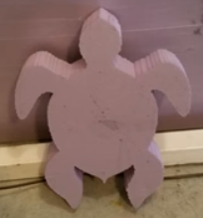
Experiments With Foam-Polargraph type foam cutter
Put two drawing robots together face-to-face holding plates with a hole in the center. A resistive heater wire is passes through the holes freely. The weight of the cables keeping the wire taught. The two sides move independently, so 3D shapes can be made. Just like with the Bailey Blade, the slope of each section is maintained to make a smooth object.
These shapes took around 1 minute to cut. Try to 3D print these that fast!
https://youtu.be/63pT0VODFXA

